Slide 1
Chapter 4
4.2 Principal Components Analysis

Slide 2
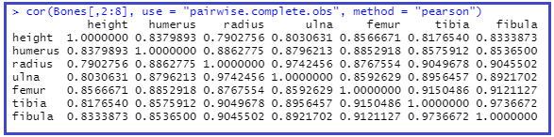
Return to the Bones Data
For complete skeletal remains, I’d like to find a model for predicting height. However, look at the correlations
between bone lengths. What I’d like to do is replace the 6 correlated variables with a smaller set of uncorrelated
variables, which captures as much information in the original variables as possible.
The principal components (these uncorrelated variables) are linear combinations of the original observed variables
(or z-scores of the original observed variables).

Slide 3
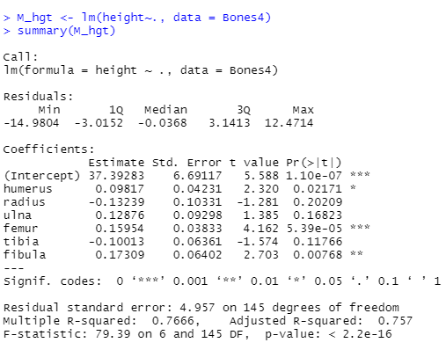
Relationship between bone length and height

Slide 4
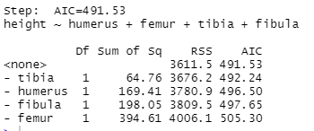
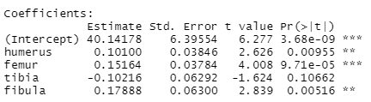
Stepwise Regression: Backward
Interpret slopes, does this make sense?

Slide 5
Principle Components Analysis (PCA)
Explains correlation structure of predictor variables by using a smaller set of linear combinations of these variables
linear combinations are called components
Total variability of the dataset of m variables can often almost entirely be explained by k components, where m>k
analyst can replace original m variables with the k<m components
modified dataset has n records with k components
Suppose original variables X₁, X₂,…, X_{m} form a coordinate system in m-dimensional space
principle components represent a new coordinate system found by rotating the original system along the directions of maximum variability

Slide 6
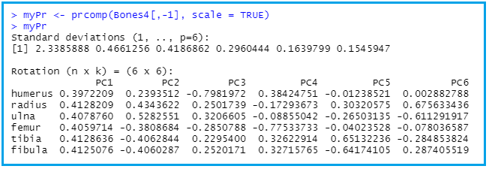
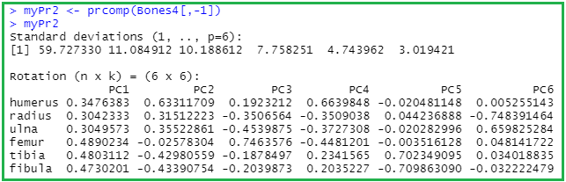
Principal Components Analysis (PCA)

Slide 7
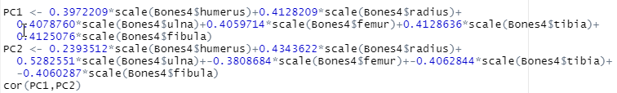

Components orthogonal; Correlation= 0

Slide 8
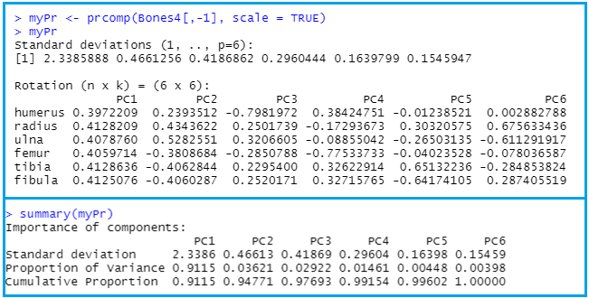
myPr

Slide 9
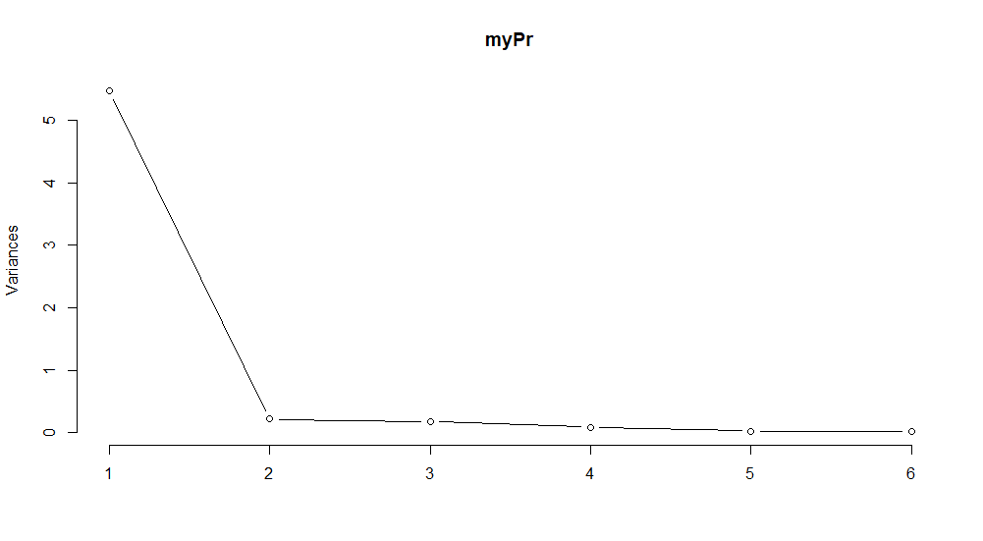
Scree plot: plot(myPr, type = "l")

